Slide 1
HRT Track: Optimizing Public Transport Scheduling
Xinjin Li, Yuchen Ge, Yixiao Yuan, Wenbo Liu

Slide 2
Optimization Objective
Waiting Time for Passengers: Aim for minimum average waiting time.
Number of Departures: Reduce departures to cut operational costs, with cost differentiation based on time of day.
Crowdedness : Measure as the ratio of average passenger count to train capacity across all trips.

Slide 3
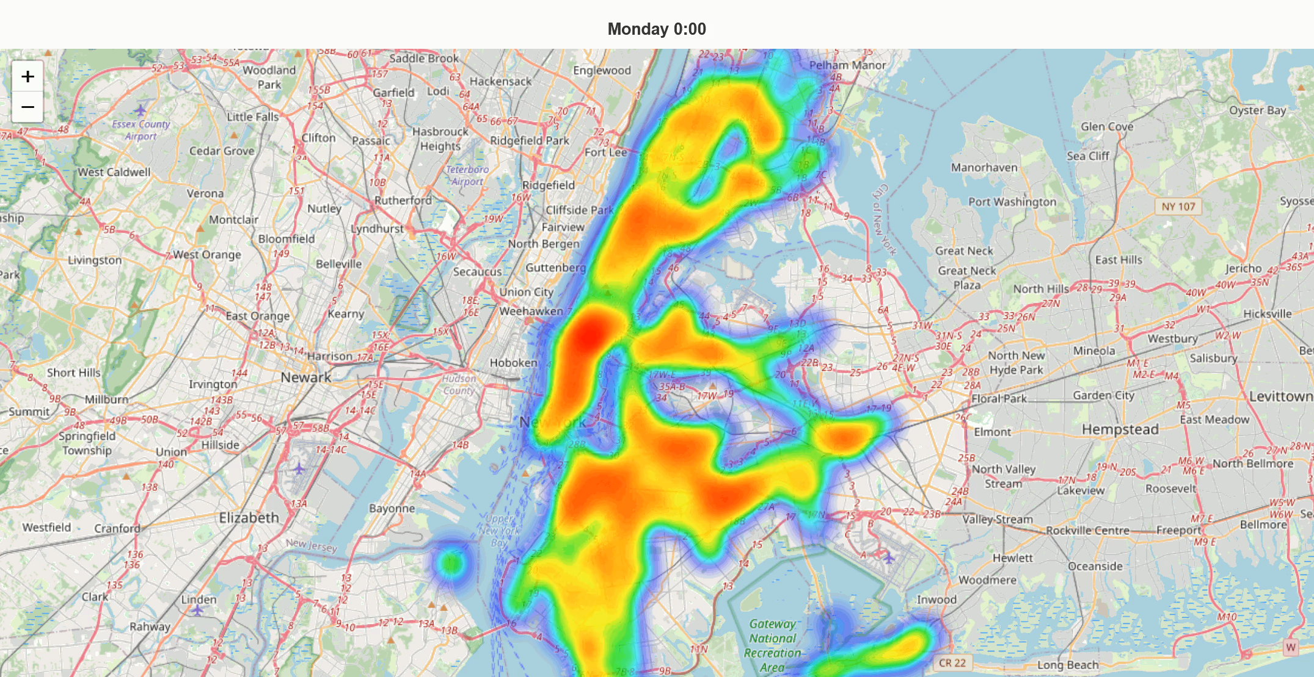
Determining Departure Time Based on Passenger Flow
With accurate passenger flow data, we can calculate the optimal departure time.

Slide 4
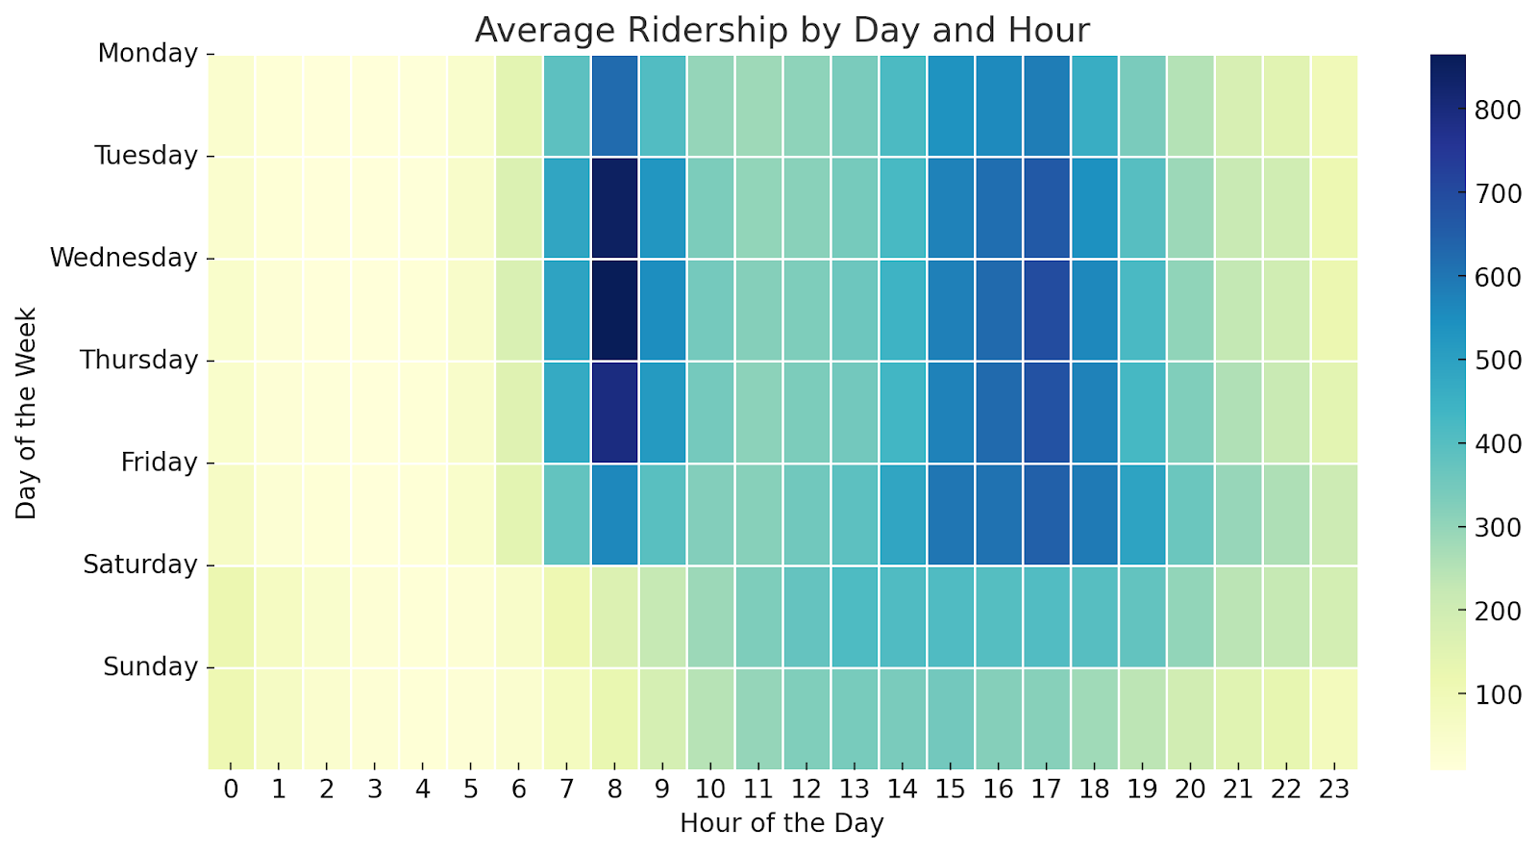
Passenger Flow Prediction
Exploratory Data Analysis (EDA)

Slide 5
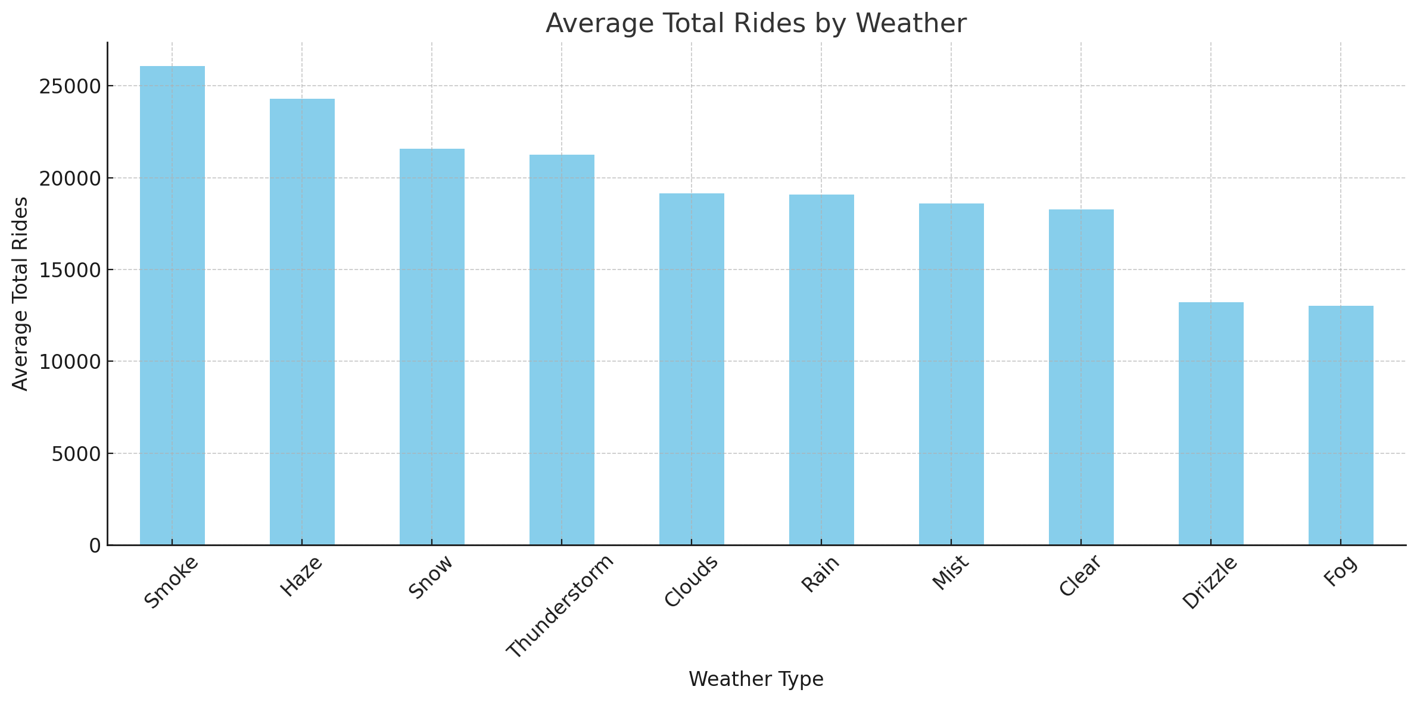
Passenger Flow Prediction
Exploratory Data Analysis (EDA)

Slide 6
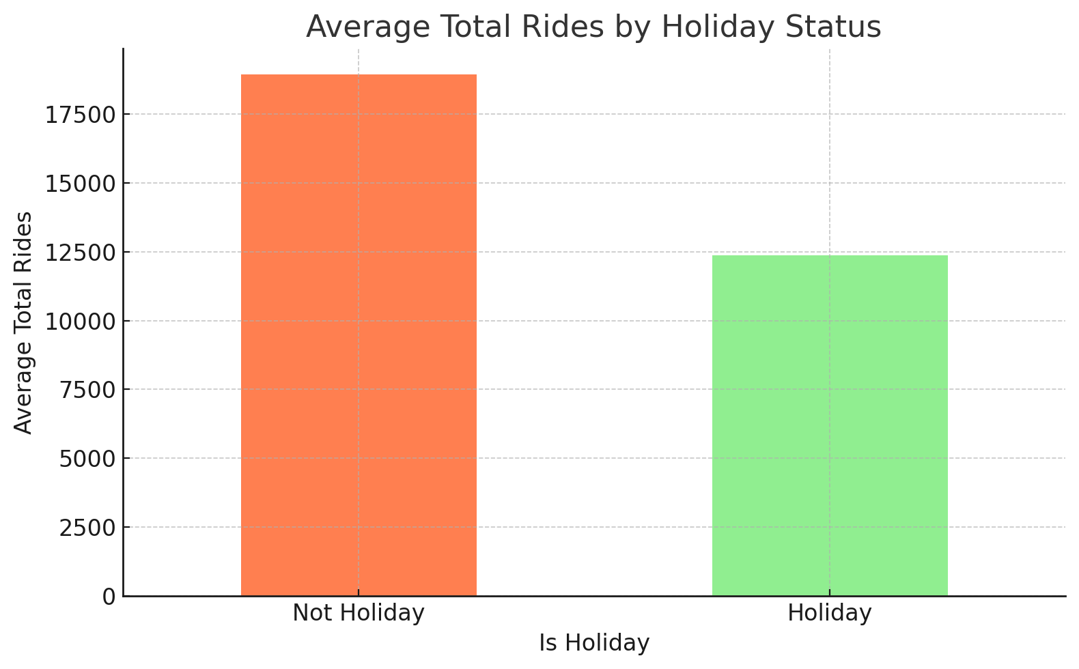
Passenger Flow Prediction
Exploratory Data Analysis (EDA)

Slide 7
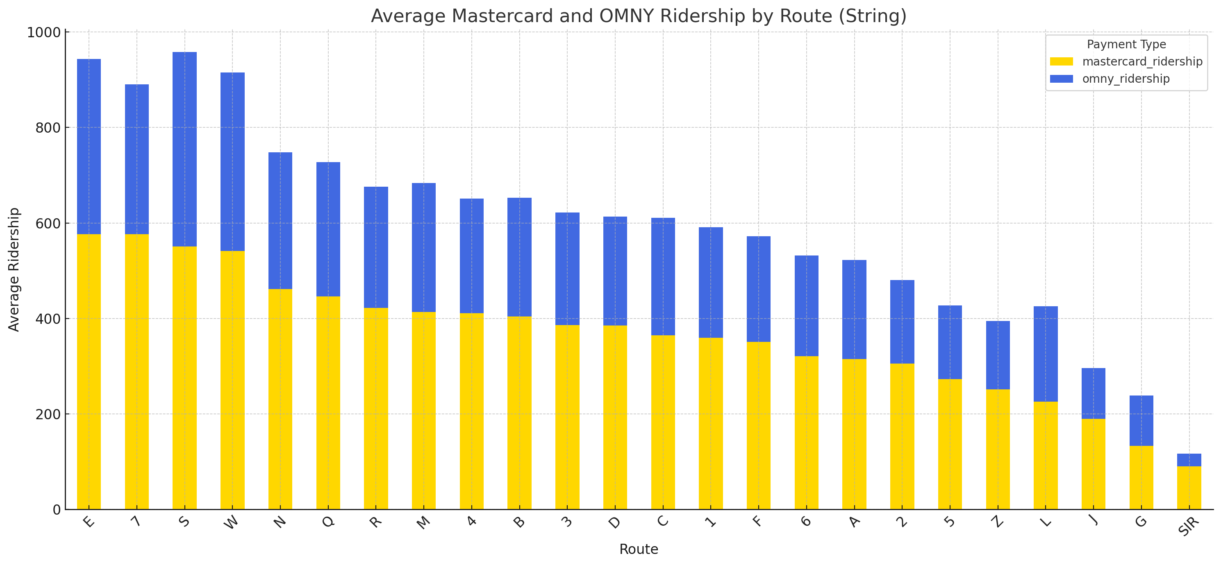
Passenger Flow Prediction
Exploratory Data Analysis (EDA)

Slide 8
Passenger Flow Prediction
Feature Selection
Weather
Day of the Week
Holiday Flag
Average Passenger Flow (Historical Data)
Subway Line
Time (24-hour format, Discretized)
Experiment setting
Use data before 2023-05-01 as the training set
Use data after 2023-05-01 as the test set

Slide 9
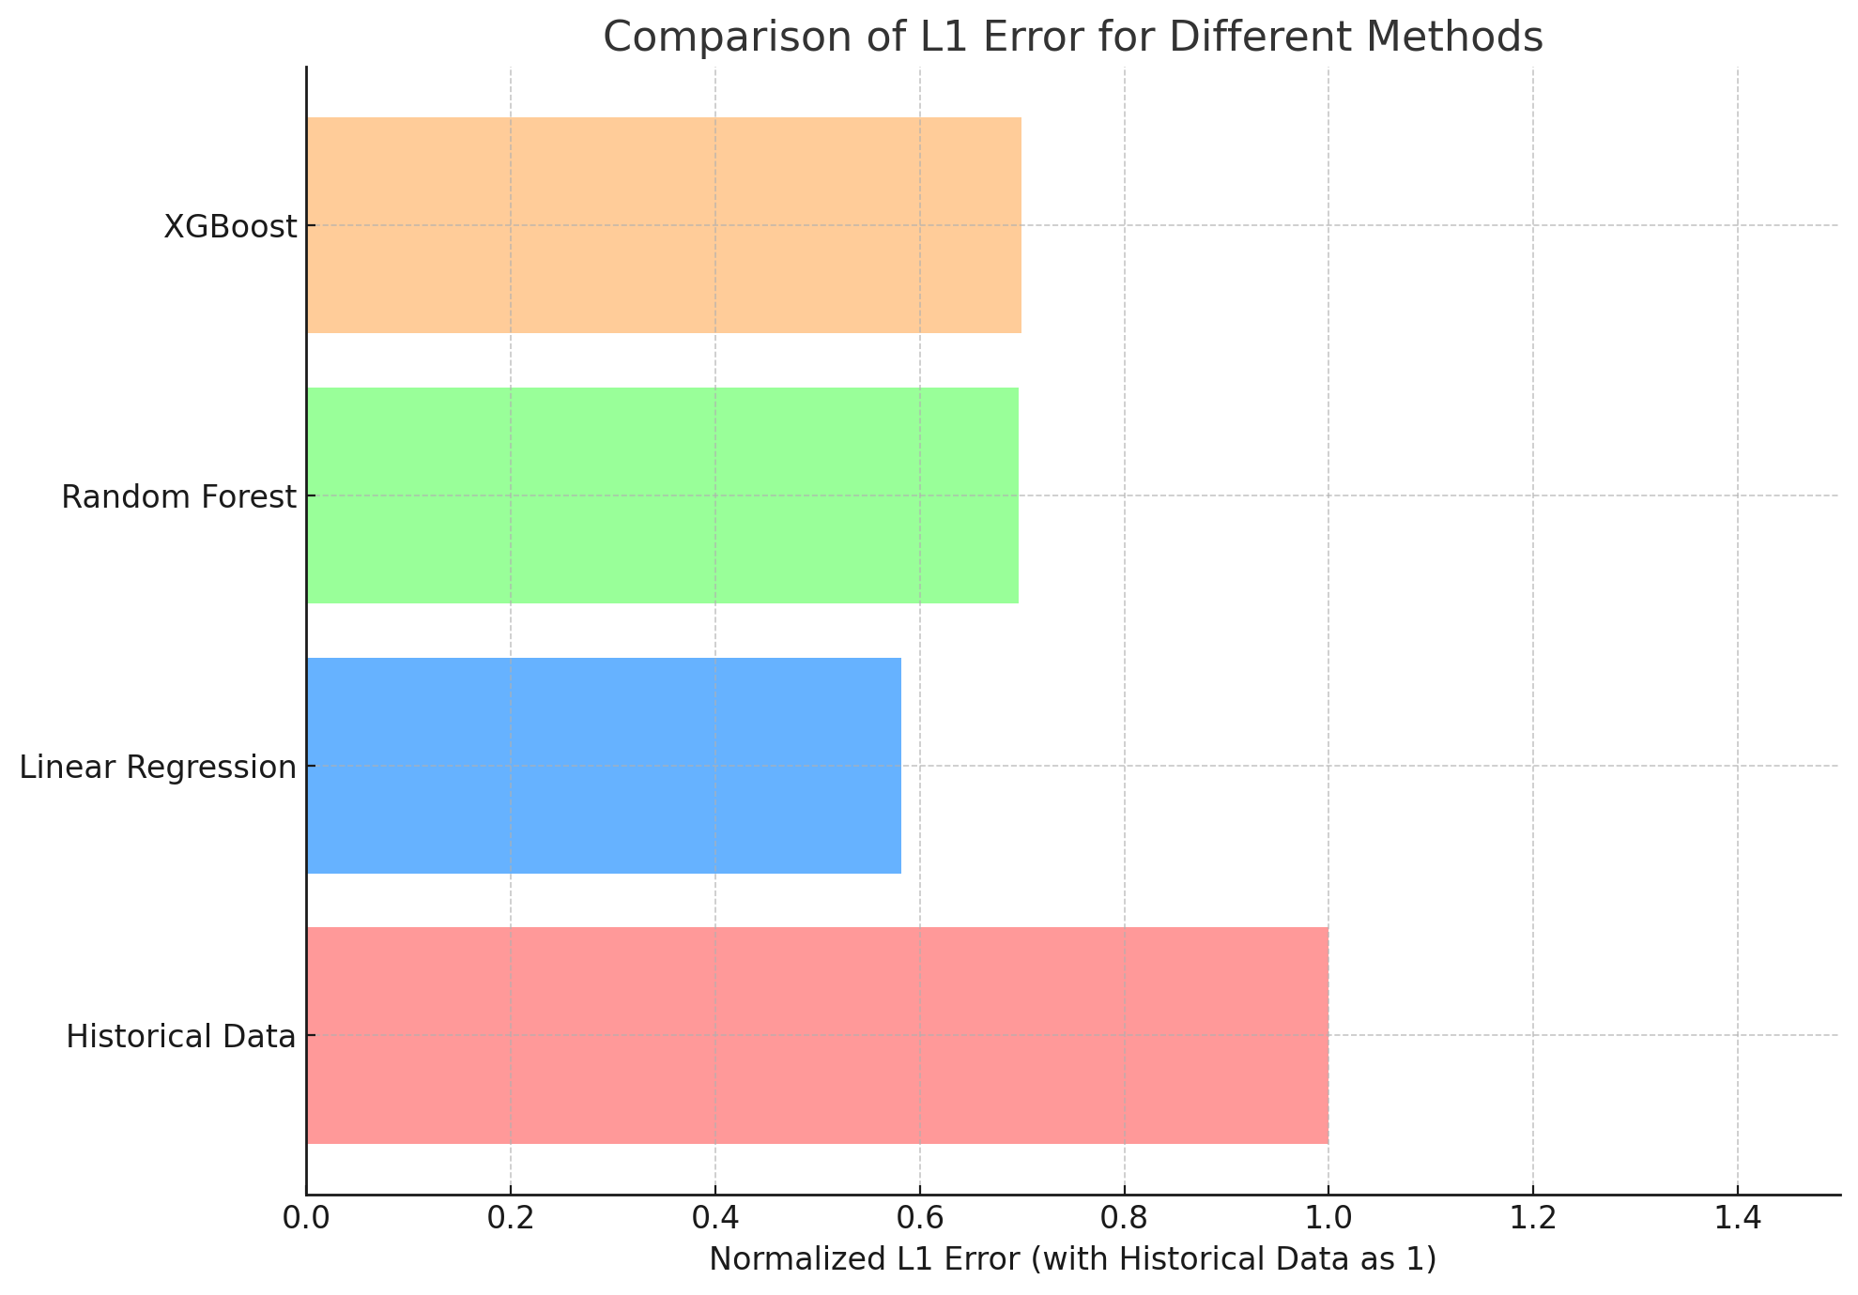
Passenger Flow Prediction
Result (compared to using historical data directly)

Slide 10
Predicting Departure Intervals for Public Transport
Our Primary Goal: Predict optimal departure intervals.
Evaluation Metric: Cost = w1 ⋅ (Waiting Time) + w2 ⋅ (Number of Departures) + w3 ⋅ (Crowdedness).
Algorithm Implementation
Using Simulated Annealing: A metaheuristic technique.
Chosen for its efficiency in searching vast solution spaces.

Slide 11
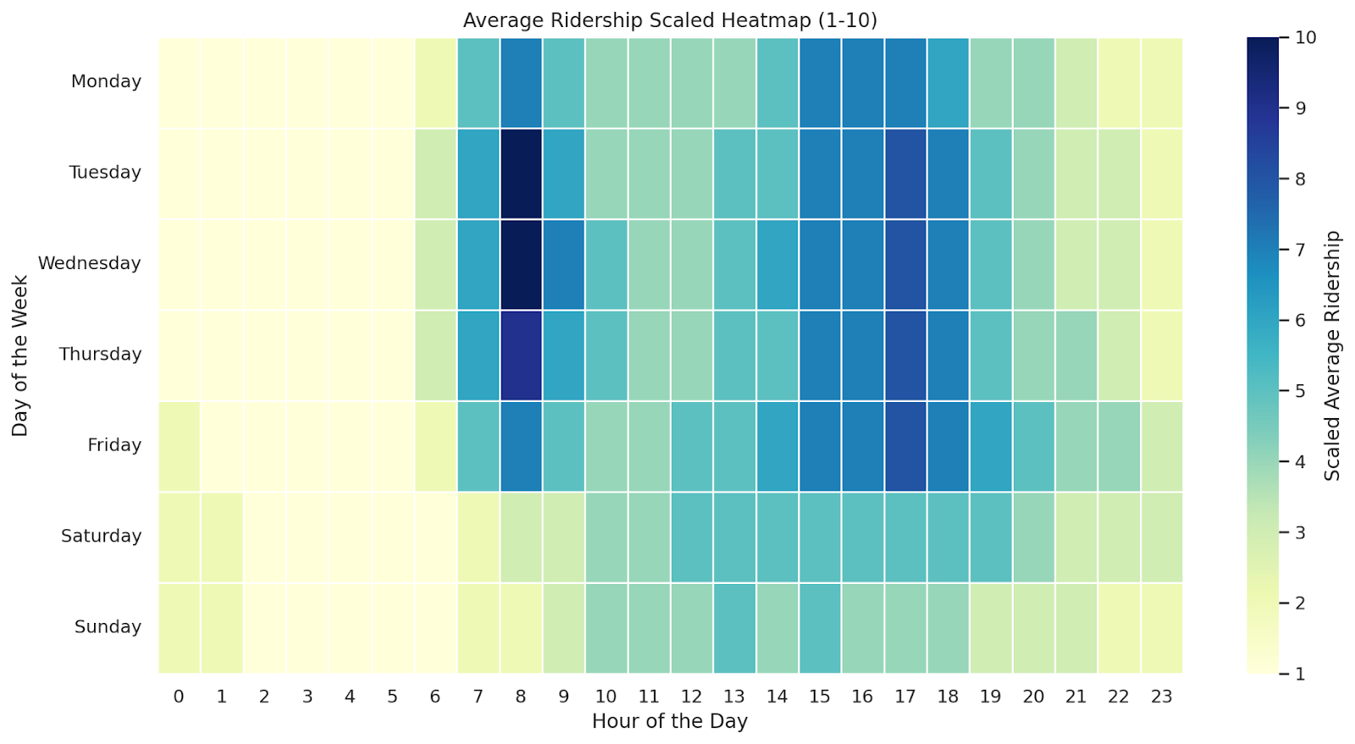
Predicting Departure Intervals for Public Transport
Our schedule (for Line E in a sunny week)

Slide 12
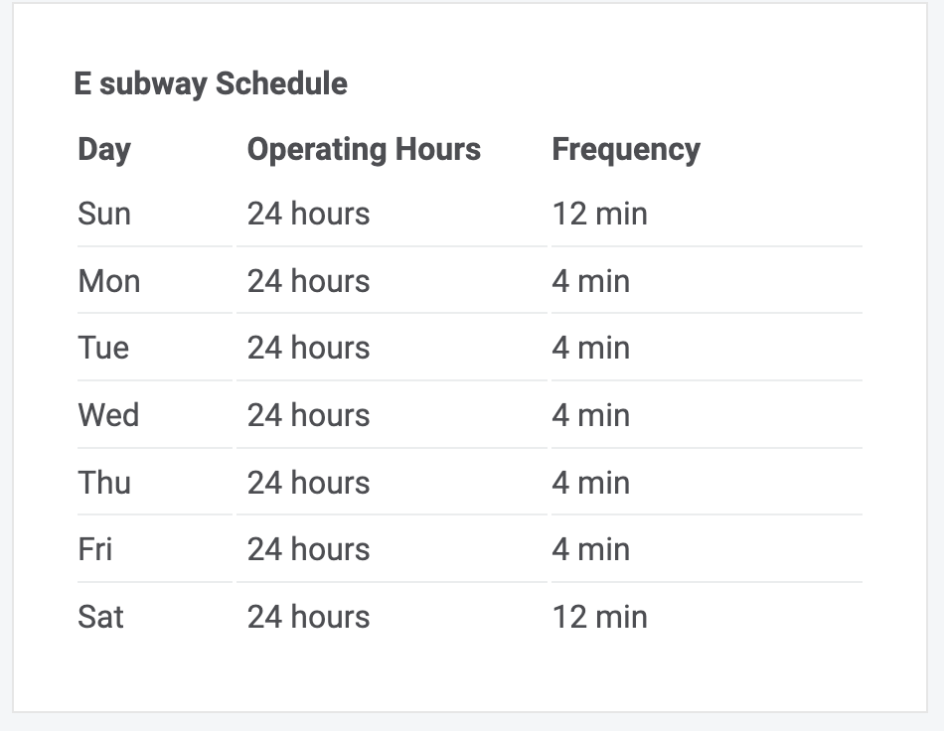
Predicting Departure Intervals for Public Transport
Comparing with official schedule in the test set
Waiting Time for Passengers -29%
Crowdedness -12%

Slide 13
Conclusion
Balanced Optimization
Data-Driven Approach
Dynamic Scheduling
Real-world Impact

Slide 14
Future Steps
Re-evaluate Objective Function Weights
Improve Passenger Flow Predictions
Pilot in Different Regions
Engage with Stakeholders

